Slide 2
Learning objectives
Understand massive scale data management and processing with Hadoop
Understand and able to use Hadoop components for big data platform designs
Able to integrate Hadoop with other frameworks for data ingestion and analytics systems
Notes:
https://www.youtube.com/watch?v=aReuLtY0YMI
https://www.youtube.com/watch?v=JWX5Inb--ig

Slide 3

●
●
●
●
Hbase and Hive

Slide 4

●
●
●
●
Hbase and Hive

Slide 5
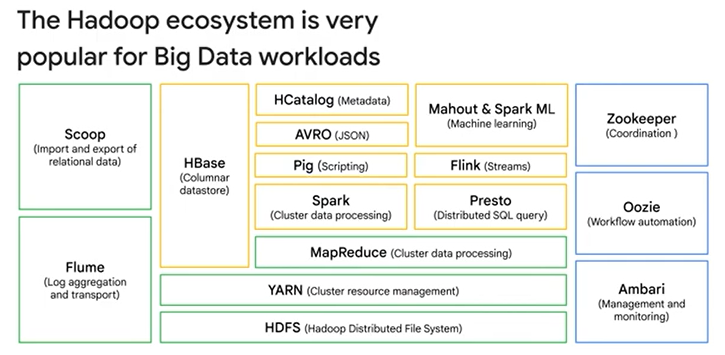



Slide 6





Slide 7
Hadoop
The goal is to combine storage and processing in the same cluster system
Designed for massive scale of data and computing with shared nothing architecture
commodity hardware, highly scalability, fault tolerance, easy to extend
Suitable for both on-premise and clouds
There are very rich software ecosystems centered
around Hadoop
Notes:
Hadoop In 5 Minutes | What Is Hadoop? | Introduction To Hadoop | Hadoop Explained |Simplilearn
https://www.youtube.com/watch?v=aReuLtY0YMI&t=315s

Slide 8
Hadoop history
Doug Cutting and Mike Cafarella in the year 2002 worked Apache Nutch project
In 2003, they came across a paper that described the architecture of Google’s distributed file system, called GFS (Google File System)
In 2004, Google published one more paper on the technique MapReduce
in 2006, Doug Cutting joined Yahoo along with Nutch project
Doug Cutting had a two-year-old son who had named his toy elephant Hadoop
In 2007, Yahoo successfully tested Hadoop on a 1000 node cluster and start using it.
Notes:
https://www.geeksforgeeks.org/hadoop-history-or-evolution/

Slide 9

Hadoop history
In December of 2011, Apache Software Foundation released Apache Hadoop version 1.0.
And later in Aug 2013, Version 2.0.6 was available.
And currently, we have Apache Hadoop version 3.0 which released in December 2017
Notes:
https://www.geeksforgeeks.org/hadoop-history-or-evolution/

Slide 10



Slide 11
Hadoop: layers
Com mon
MapReduce |  | others
YARN
Hadoop File System (HDFS)
others
Cluster
(of shared nothing nodes)

Slide 12
Hadoop key components
HDFS as a distributed file system
for managing data
YARN as a resource management system
for executing and managing analytics tasks
MapReduce as one programming model
for MapReduce applications
Hadoop Common:
Libraries and utilities, which provide tools and infrastructure for the entire Hadoop ecosystem, such as authentication, configuration, and logging.

Slide 13
●
●
●
●

Slide 15
Hadoop File System (HDFS)
For handling very big data files
GBs of data within a single file
Assumption of data handling
write-once-read-many
not suitable for random-access update → analytics data
Deal with hardware failures, support data locality, reliability
“high fault tolerance” with “low-cost/commodity hardware”

Slide 16
HDFS Architecture
Namenode
Manages the file system namespace.
Regulates client’s access to files.
It also executes file system operations such as renaming, closing, and opening files and directories
Datanode
Datanodes perform read-write operations on the file systems, as per client request.
They also perform operations such as block creation, deletion, and replication according to the instructions of the namenode.
Block data

Slide 17

https://hadoop.apache.org/docs/r1.2.1/hdfs_design.html

Slide 18
Datanodes
NAME NODE
1
4
5
3
6
1
2
8
3
7
8
5
7

Slide 19
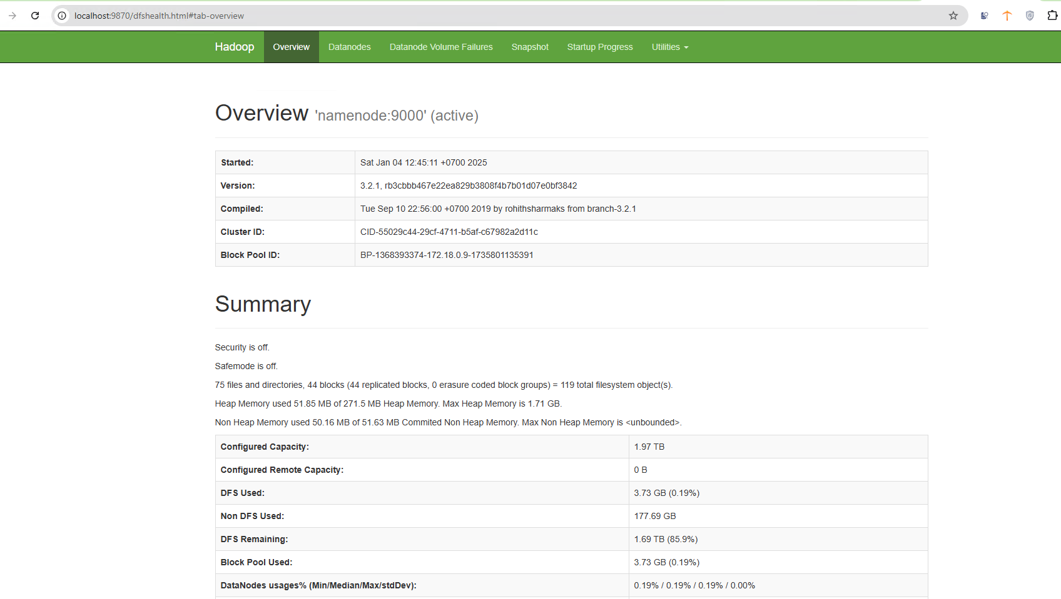

Slide 20
Datanodes
1
4
5
3
6
1
2
8
3
7
8
5
7

Slide 21
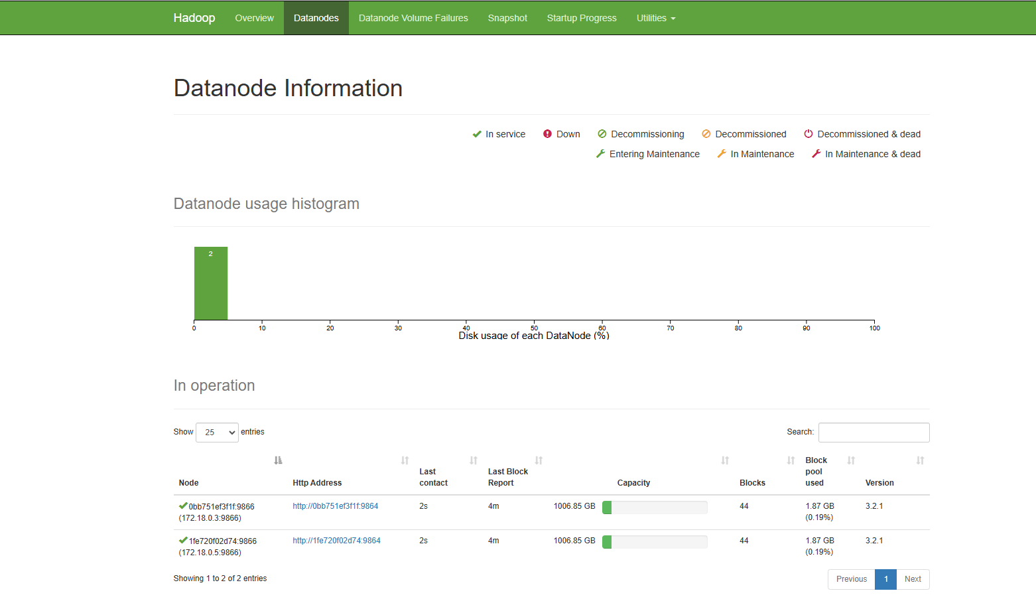

Slide 22
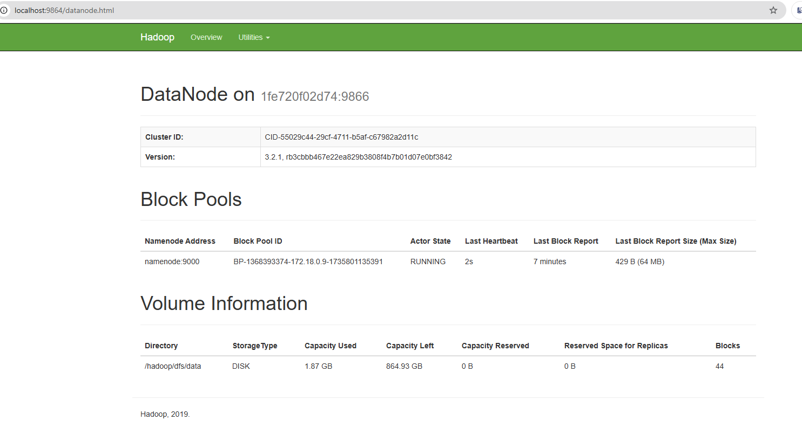

Slide 23
Datanodes
1
4
6
1
2
3
8
3
7
8
5
7
5

Slide 24
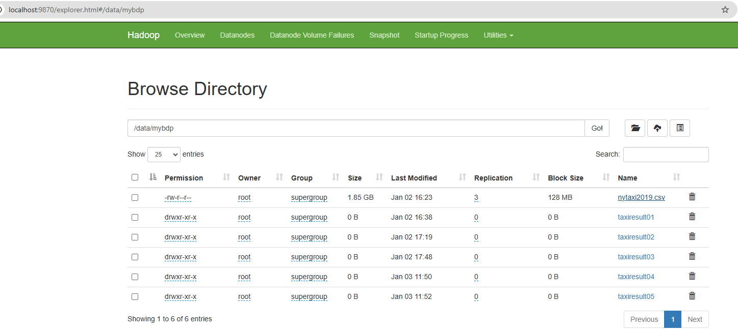

Slide 25
Datanodes
1
4
6
1
2
3
8
3
7
8
5
7
5
1
3
New datanode is created by the namenode

Slide 26
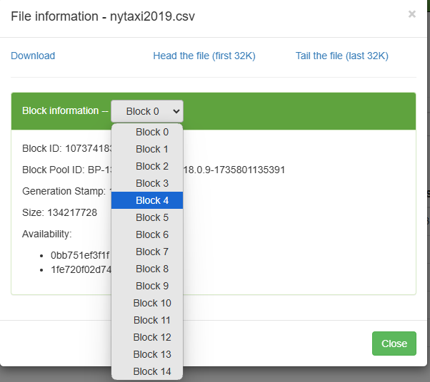

Slide 27
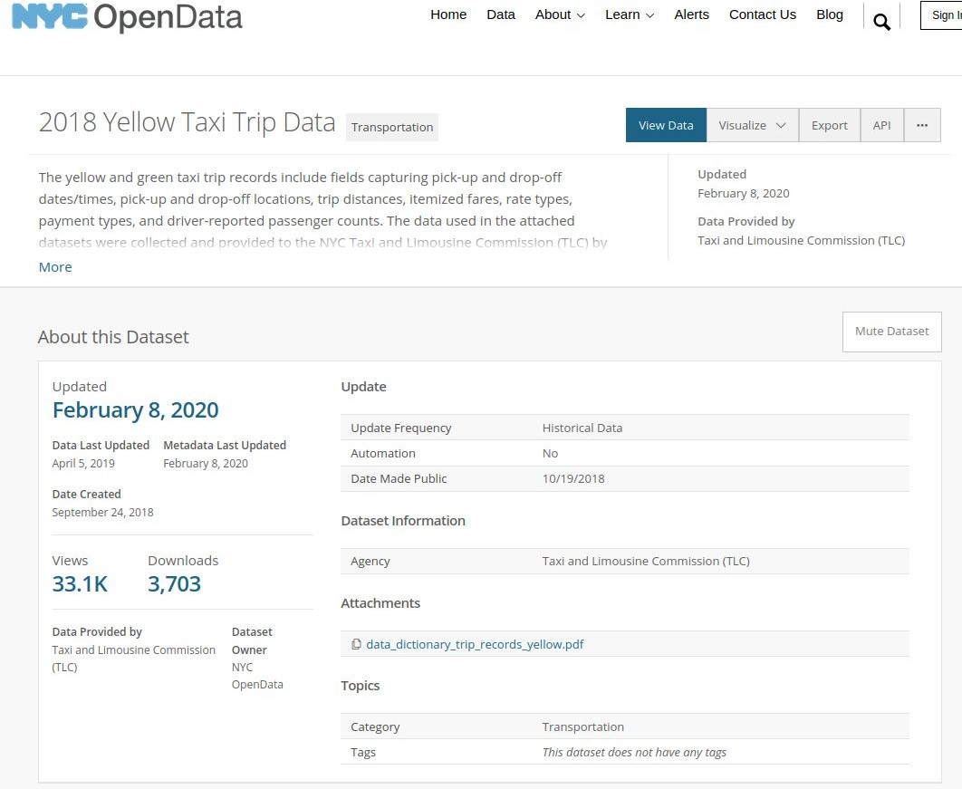
Example
e.g., 112M rows
Snapshot from: https://data.cityofnewyork.us/Transportation/2018-Yellow-Taxi-Trip-Data/t29m-gskq

Slide 28
HDFS - data blocks
Files are stored in many nodes
but the application accesses HDFS files just like “typical file systems”
A file includes many blocks
File blocks are replicated and distributed across nodes
Conventional way of access data
naming resolving: hdfs://
common operations: list, put, get, …

Slide 29
File blocks, metadata and data replication
Block size is 128MB (default)
can be configurable but should not be small size
all blocks of the same file are the same, except the last one
Data is replicated across the cluster
usually, replication factor is 3
NameNode manages file system metadata

Slide 30
HDFS fault tolerance
Data blocks
File blocks are replicated and distributed across nodes
Rack awareness
avoid communication problems between nodes in different racks
Monitoring
DataNode reports to NameNode
Read and write
using NameNode for metadata and for information of DataNodes
NameNode has replication (master-worker)

Slide 31
Compatible file systems with HDFS
Many file systems are compatible with HDFS
for integration and analysis purpose: m
Examples:
Amazon S3
Azure Blob Storage
Azure Data Lake Storage
OpenStack Swift

Slide 32
●
○
■
○
○

Slide 33



Slide 34
Notes:
https://youtu.be/9ArtEmpop7w?t=463
https://www.youtube.com/watch?v=olnBmYHPAf8
https://youtu.be/9ArtEmpop7w?t=272 – YARN workflow
https://www.youtube.com/watch?v=GCFCohlmWgs&pp=ygULeWFybiBoYWRvb3A%3D – YARN works

Slide 35

Notes:
Scheduler: có nhiệm vụ cung cấp tài nguyên cho các ứng dụng sử dụng, nó là thuần scheduler và không có nhiệm vụ quản lý hay theo dõi tình trạng của ứng dụng, hoặc như việc restart các task bị fail. Việc cung cấp tài nguyên là dựa trên yêu cầu cảu ứng dụng, các tài nguyên như RAM, core,.. Việc này cũng dựa trên các chính sách chia nhỏ tài nguyên thành các queue, các chính sách như CapacityScheduler và FairScheduler.
ApplicationManager: Có nhiệm vụ tiếp nhận các job từ client, cấp phát tài nguyên để start ApplicationMaster cho từng ứng dụng, đồng thời cung cấp dịch vụ restart ApplicationMaster trong trường hợp lỗi.
NodeManager được cài trên 1 node có nhiệm vụ quản lý tài nguyên (RAM, core...) và job trên node đó. NodeManager thường xuyên gửi heartbeat đến RM thông báo tình trạng, mục đích chính của NM là quản lý các container mà RM giao cho nó, kill các container này nếu RM yêu cầu.

Slide 36
Worker A
Master Node
Spark Hadoop YARN
Worker B
Notes:
Container là tiến trình của YARN, tập hợp các tài nguyên vật lý như core, RAM. YARN container được quản lý bới đối tượng Container Launch Context, đối tượng này lưu trữ các thông tin như biến môi trường, dependencies, security tokens và các chỉ thị để tạo tiến trình. Container cấp quyền cho các ứng dụng chạy trên nó sử dụng một lượng tài nguyên nhất định.
Việc thực thi job sử dụng Hadoop YARN bao gồm 3 bước chính:
Client submit application tới YARN
YARN khời tạo ApplicationMaster tương ứng với chương trình đó.
ApplicationMaster quản lý thực thi của chương trình trên các containers.

Slide 37
AM = Application Master NM = Node Manager
Worker A
NM A
AM 1
Resource Manager
Capacity Scheduler
Worker B
NM B
AM 2
Notes:
Chi tiết các bước như sau:
1. Client submit job đến ResourceManager bao gồm các bước, tài nguyên cần thiết để khởi tạo ApplicationMaster.
2. ResourceManager cấp phát tài nguyên và start ApplicationMaster.
3. AppMaster đăng ký với ResourceManager cho phép client giao tiếp trực tiếp đến AppMaster.
4. AppMaster sau đó request tài nguyên container từ ResourceManager.
5. Sau khi xin được tài nguyên từ RM, AppMaster cung cấp cho NodeManager chỉ dẫn để khởi tạo các container trên NM đó. Các container sau đó giao tiếp trực tiếp với AppMaster.
6. Việc thực thi job trên container báo cáo lại tiến độ công việc cho AppMaster.
7. Trong khi chương trình thực thi, client giao tiếp trực tiếp với AppMaster để nhận thông tin về tình trạng cung như cập nhật tiến độ công việc.
8. Khi chương trình hoàn tất, AppMaster ngắt kết nối với ResourceManger và off các containers.

Slide 38
AM = Application Master NM = Node Manager
Worker A
NM A
AM 1
Resource Manager
Capacity Scheduler
Worker B
NM B
AM 2

Slide 39
AM = Application Master NM = Node Manager
Worker A
NM A
AM 1
Resource Manager
Capacity Scheduler
Worker B
NM B
AM 2

Slide 40
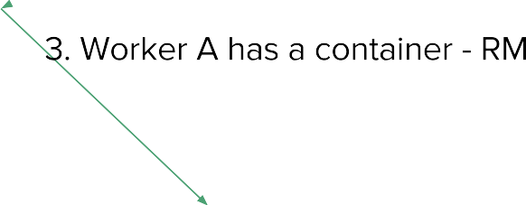
AM = Application Master NM = Node Manager
Worker A
NM A
AM 1
Resource Manager
Capacity Scheduler
Worker B
NM B
AM 2

Slide 41
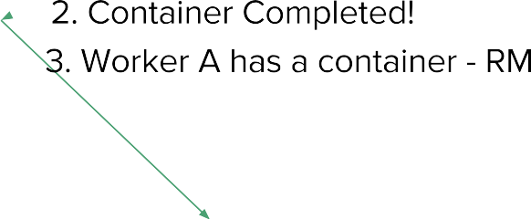
AM = Application Master NM = Node Manager
Worker A
NM A
AM 1
Resource Manager
Capacity Scheduler
Worker B
NM B
AM 2

Slide 42

AM = Application Master NM = Node Manager
Worker A
NM A
AM 1
Task
Resource Manager
Capacity Scheduler
Worker B
NM B
AM 2

Slide 43
AM = Application Master NM = Node Manager
Worker A
NM A
Task 1
AM 1
Resource Manager
Task 2
Capacity Scheduler
Worker B
NM B
AM 2

Slide 44
YARN (Yet Another Resource Negotiator)
Manage resources for processing tasks
each node in the cluster provides resources for executing tasks
Computing resource types:
CPU, Memory and Disks
also support GPU and FPGA Node
Computing resources are abstracted into “Containers”
don’t be confused: it is not a (Docker) container!
Multi-tenancy support
Notes:
Container là tiến trình của YARN, tập hợp các tài nguyên vật lý như core, RAM. YARN container được quản lý bới đối tượng Container Launch Context, đối tượng này lưu trữ các thông tin như biến môi trường, dependencies, security tokens và các chỉ thị để tạo tiến trình. Container cấp quyền cho các ứng dụng chạy trên nó sử dụng một lượng tài nguyên nhất định.

Slide 45

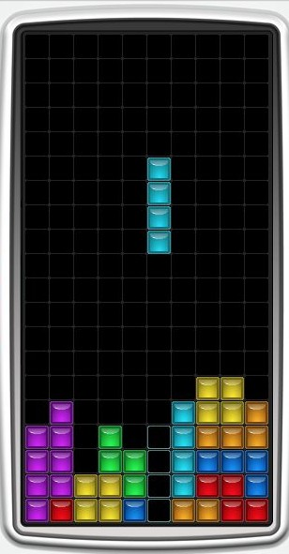
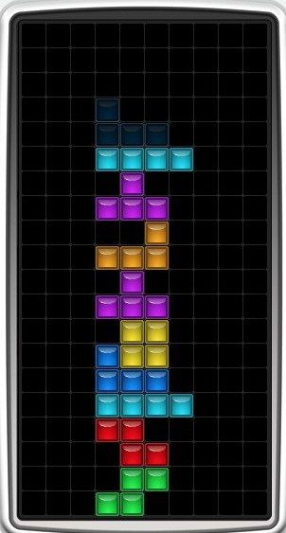

With a scheduler
Without a scheduler

Slide 47

RM = Resource Manager AM = Application Master NM = Node Manager

Slide 48
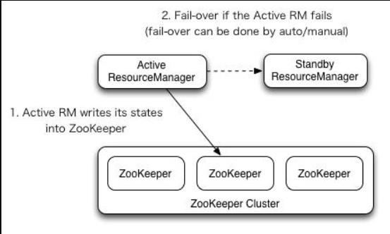
ResourceManager HighAvailability
Notes:
Nhìn vào kiến trúc của YARN ta có thể dễ dàng nhận thấy kiến trúc này khiến cho ResourceManager trở thành điểm chết. Giống như NameNode trong HDFS, ResourceManager có kiến trúc High Availability để tăng khả năng chịu lỗi. Theo đó tại một thời điểm, trong cụm tồn tại duy nhất một active RM và một hoặc nhiều RM là standby có thể lên thay thế active RM nếu bị lỗi. Việc thay đổi active-standby giữa 2 RM có thể thực hiện manually hoặc automatically.
Manually transition and failover: Nếu bạn ko bật automatically failover thì việc thực hiện manually failover thông qua lệnh yarn rmadmin. Thứ tự chuyển sẽ là active RM thành standby và stanby sau đó lên thành active ResourceManager.
Automatic failover: ResourceManager có nhúng một tiến trình Zookeeper-based ActiveStandbyElector thực hiện việc failover giữa hai RM. Không giống như ở NameNode cần phải chạy tiến trình ZKFC riêng biệt (chi tiết về NameNode HA tham khảo tại đây)
Client, Applicationmaster and NodeManager on RM failover: Client, ApplicationMaster và NodeManager đều được cấu hình giao tiếp với cả hai RM cùng lúc, các service này kết nối đến 2 RM theo cơ chế round-robin đến khi gặp được active RM, nếu trong quá trình running active RM bị down, các service này tiếp tục thực hiện kết nối round-robin đến khi gặp được active RM mới.

Slide 49
Task Worker C
Worker A
Data Block 1
NM C
NM A
AM 3
AM 1
MapReduce
Task Worker D
YARN // Resource Manager
NM D
AM 4
HDFS // Name Node
Worker B
Data Block 2
NM B
AM 2

Slide 50
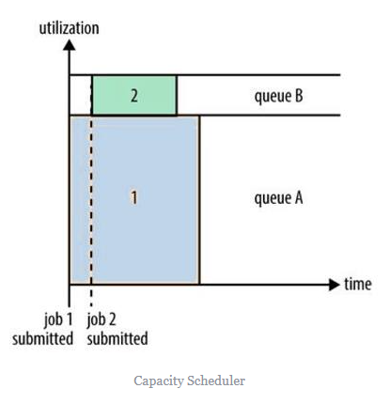
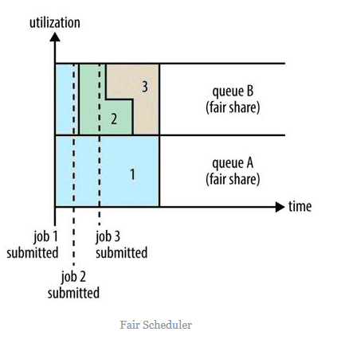
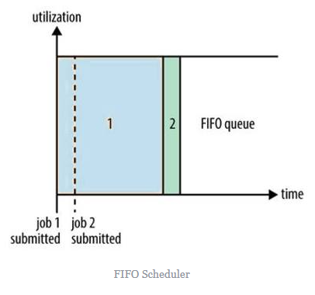
YARN Scheduler Policies
FIFO Scheduler
Capacity Scheduler
Fair Scheduler
Notes:
FIFO nghĩa là First In First Out, các job submit trước sẽ thực hiện trước, giống như trong hàng đợi.
Capacity Scheduler chia tài nguyên trong YARN thành các queue, ứng dụng sẽ submit job lên các queue này trong YARN, các queue sẽ được cấu hình một lượng tài nguyên nhất định và có thể sử dụng nhiều hơn up-to max cấu hình nếu có nhiều tài nguyên đang free.
Nếu như Capacity Scheduler yêu cầu bạn phải dự trữ trước 1 lượng tài nguyên cho các queue thì Fair Scheduler không như vậy. Fair Scheduler sẽ tự động cân bằng tài nguyên giữa các queue running. Nếu job đầu tiên submit, nó sẽ chiếm toàn bộ tài nguyên trong cụm, đến khi có job 2 submit, tài nguyên sẽ dần cân bằng lại 50% giữa 2 queue.
https://hadoop.apache.org/docs/current/hadoop-yarn/hadoop-yarn-site/CapacityScheduler.html
https://hadoop.apache.org/docs/current/hadoop-yarn/hadoop-yarn-site/FairScheduler.html

Slide 51
Programming models
YARN is an execution environment
YARN allows different programming models for applications
MapReduce
Apache Spark
Workflows
E.g., Apache Tez for DAG (direct acyclic graph) of data processing tasks

Slide 52
Integration models
Using Hadoop for developing large-scale data analysis
Apache Spark, HBase, Hive, Apache Tez
Using Hadoop HDFS as components in a big data system
Hadoop HDFS can become data storage → storage layer
emerging data lake models, combined batch and stream ingestions for incremental data processing
e.g., Apache Hudi

Slide 53







ETL and Analytics with Hadoop/HDFS
Analysis
Data
Data
Application
Data
Source1
Source1
Database
Source n
result
Ingestion Engine
Analysis Engine
Analysis
HDFS
Data Ingestion:
Hadoop (and additional frameworks)
HDFS Client/Hadoop Streaming
Computing/Data Processing Framework
Apache Spark
HDFS as storage for databases
Accumulo, Druid, etc.
Spark Streaming
Kafka Connect
Apache Nifi
Hadoop MapReduce
Apache Tez

Slide 54
●
●
●
●

Slide 55

●
●
○
$ hadoop jar $STREAMING_JAR \
-files mapper.py,reducer.py
-mapper mapper.py -reducer reducer.py \
-input /shared/my_cool_dataset -output my_job_out

Slide 56
●
$ python my_mr_job.py -r hadoop
--output-dir my_job_out
--no-output
# HDFS directory
# Suppress output via STDOUT
hdfs:///data/my_cool_dataset # HDFS path for input

Slide 57

●
○
●
○
○
○

Slide 58
●
○
●
○
○
○
●
○
○
○

Slide 59
●
●
●
●
Hbase and Hive

Slide 60
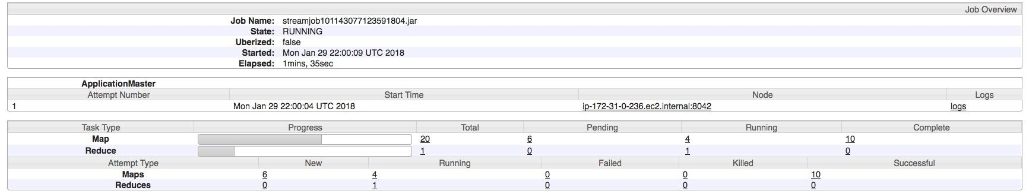

Slide 61
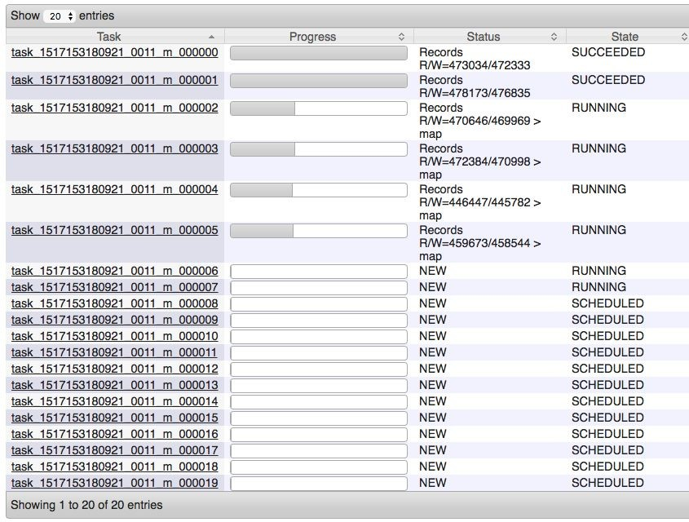

Slide 62
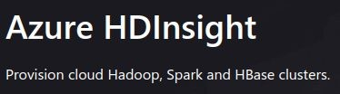
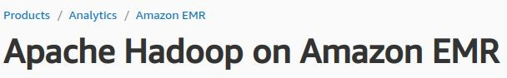

Is that Hadoop dead/unattractive?
Hadoop is for shared nothing architecture
Shared nothing architectures are not “modern”?
new, advanced developments w.r.t. memory, networks, …
in-memory processing, move data to computing nodes
Many tools seem not powerful for data science/ML?
Java vs Python development for data science and ML
services in ecosystem
near realtime analytics use cases
So why do we still study it?
foundational designs & still many Hadoop services are important (data warehouse, deep storage)
well-supported by many cloud providers for big data workloads
e.g.,

Slide 63
Why do we still need to learn Hadoop?
Hadoop file systems as a storage for many big data services
databases: Accumulo, Apache Druid
data warehouses/Data Lakes: Hive, Hudi
Support different models of access/analytics
via SQL styles atop big data platforms: You can do extract/transform/load (ETL), reporting, and data analysis using SQL styles
large-scale parallel programming (e.g., Spark)
Still many needs, given shared nothing architectures and on-premise conditions

Slide 64
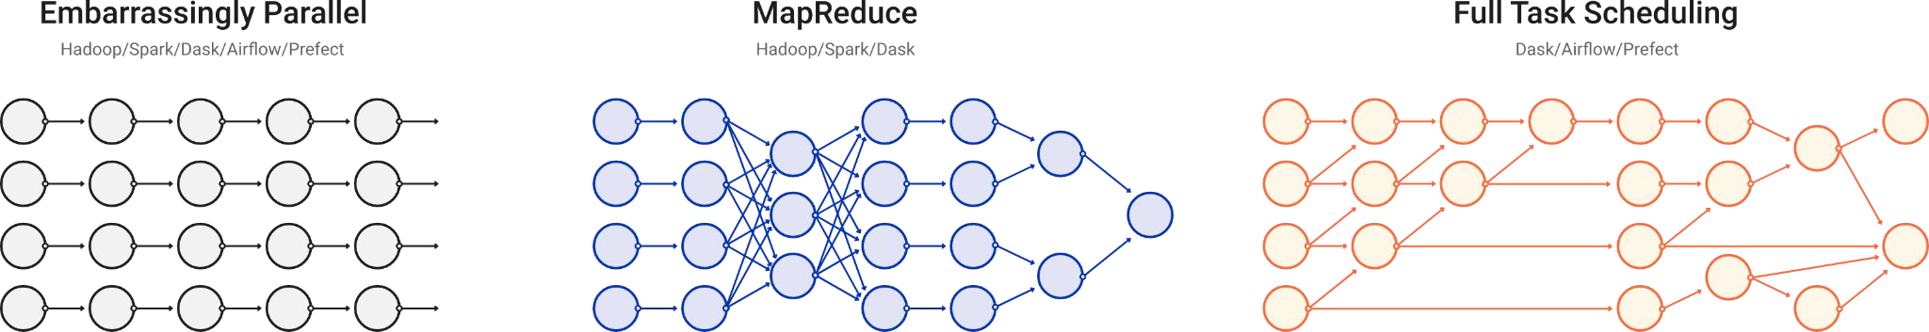

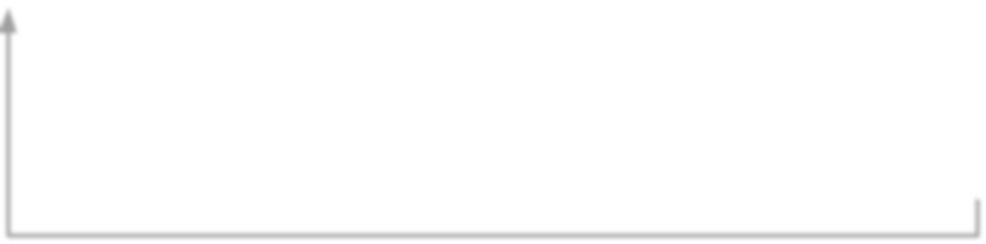

Why do we still need to learn
Hadoop?
Figure source: https://docs.dask.org/en/stable/graphs.html
needs for internal processing
SQL-style
Data parallelism
enables the implementation
Analytics/ ML
YARN Distributed executors
SQL-on-Hadoop
offers SQL features for analytics

Slide 65
Enabling analysis big data using SQL style
Provide command line tools & JDBC and server for integration
“SQL-on-Hadoop”
Examples
Apache Hive, https://hive.apache.org/
Data warehouse, access data in HDFS or Hbase
Apache Druid (using HDFS as a deep storage)
Spark SQL for various types of files

Slide 66







Integration with other cloud storage
services
Dremio | Spark | …
Driver/Connector
On-premise or cloud
Cloud
big datasets
Bucket |  | Bucket | Bucket
Node | Node |  |  | Node
Blob Storage & Data Lake in the Cloud

Slide 67
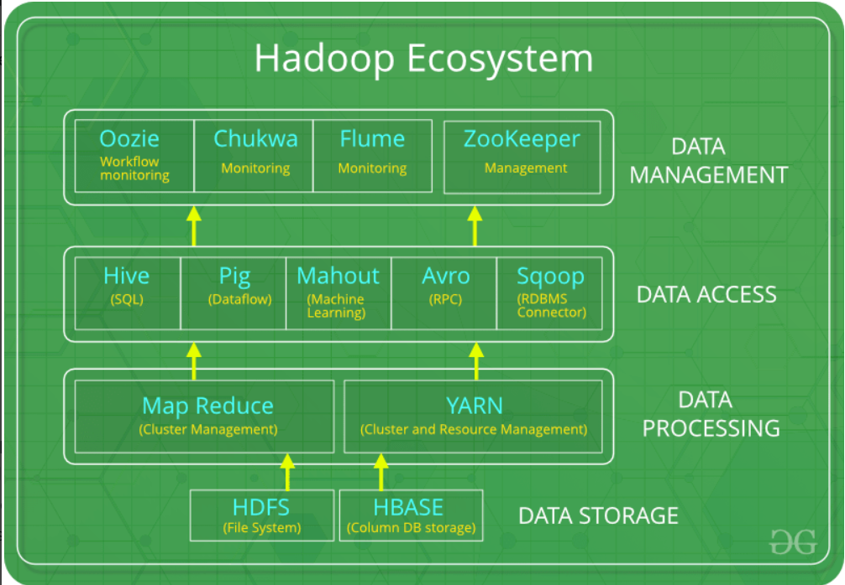
Notes:
https://cloud.google.com/bigtable/docs/hbase-differences

Slide 68

HBase
NoSQL database atop Hadoop
use HDFS for storing data
use YARN for running jobs on data
Follow a master-based architecture
Reading – Why HBase?
https://engineering.fb.com/2010/11/15/core-data/the-underlying-technology-of-messages/ https://engineering.fb.com/2014/06/05/core-data/hydrabase-the-evolution-of-hbase-facebook/ https://engineering.fb.com/2018/06/26/core-data/migrating-messenger-storage-to-optimize-performance/
Notes:
https://www.youtube.com/watch?v=cEjDR3B_3cs

Slide 69


Recall: Big data: column-family data model
Many situations we aggregate and scan few columns of million rows of data ⇒ store big data in columns enable fast scan/retrieval/aggregation
Column Family = (Column, Column, …):
for similar type of data & access patterns
Column Key =Family: qualifier
Data = (Key, Value) where Key =(Row Key, Column Key, Timestamp)

Slide 70






Example of a data model in HBase
Column
Column family (e.g., birdinfo)
Row key
Cell: versioning
species
birdinfo: country
birdinfo:eng lish_cname
duration
1
Aberti
US
…
3
2
species
birdinfo:c ountry
birdinfo:englis h_cname
duration
name
url
latitude
longitude
Text
Row
Sparsely stored: not all rows have the same number of columns

Slide 71
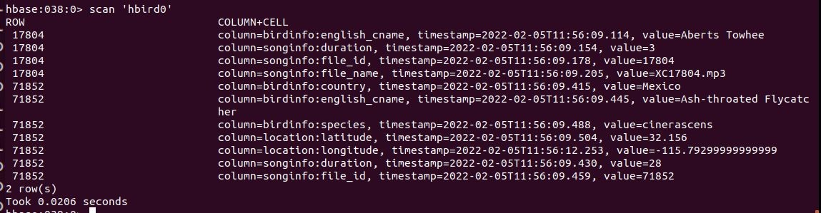
Example of a data model
Example with families: birdinfo, songinfo, location
Enable analytics based on column families (as well as data management)

Slide 72
HBase data model – sharding and storage
Table includes multiple Regions
a Region keeps related row data of a Table (partitioning)
Auto-sharding
Regions are spitted based on policies
Region has data of multiple column families
Different column families will be stored in different files
HFiles are used to store real data (also include index data)

Slide 73




HBase architecture
Zookeeper:
shared state and failure notification of servers
master address and recovery
HMaster
Zookeeper
RegionalServer
RegionalServer RegionalServer
Data Node
Data Node
HDFS
Data Node

Slide 74


HBase architecture
RegionalServer
MemStore: write cache for data in memory before written into files
BlockCache
Region
Region
BlockCache: for read cache
Store
WAL (Write
MemStore
Ahead Log)
WAL is for durability
HFile
HFile

Slide 75
ACID
Atomic within a row
Consistency
can be programmed: e.g.,
read: STRONG (read performed by the primary region) and TIMELINE (primary region first, if not, then the secondary region)
Durability
can be programmed
○ WAL (write ahead log)

Slide 76
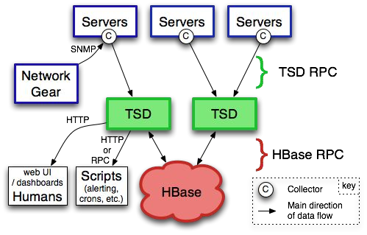
Example of using HBase
Open Scalable Open Time Series Database (OpenTSDB)
Salesforce
Salesforce Shield: for supporting data security/compliance
Field Audit Trail: for track changes
Event Monitoring: log/event
Argus: time series data and
alerts
Source:
https://engineering.salesforce.com/investing-in-big-data-apache-hbase-4 20edfba2d30/
Figure source: http://opentsdb.net/overview.html

Slide 77
Apache Hive

Slide 78
Apache Hive
https://hive.apache.org/, on top of Hadoop
data warehouse at a very large-scale
access data in large-scale storage like HDFS or S3
Support access to data via SQL styles
extract/transform/load (ETL), reporting, and data analysis using SQL styles
Provide command line tools & JDBC and server for integration
Reading – Hive in Facebook
https://engineering.fb.com/2009/06/10/web/hive-a-petabyte-scale-data-warehouse-using-hadoop/

Slide 79
High-level data flow language & programs
MegaStore
SQL-alike
Hive Shell
Hive Shell and Execution Engine
Hive script (HiveQL)
Schema
Distributed Task Execution Engine
HDFS | Amazon S3
 | Other storages
Hadoop

Slide 80



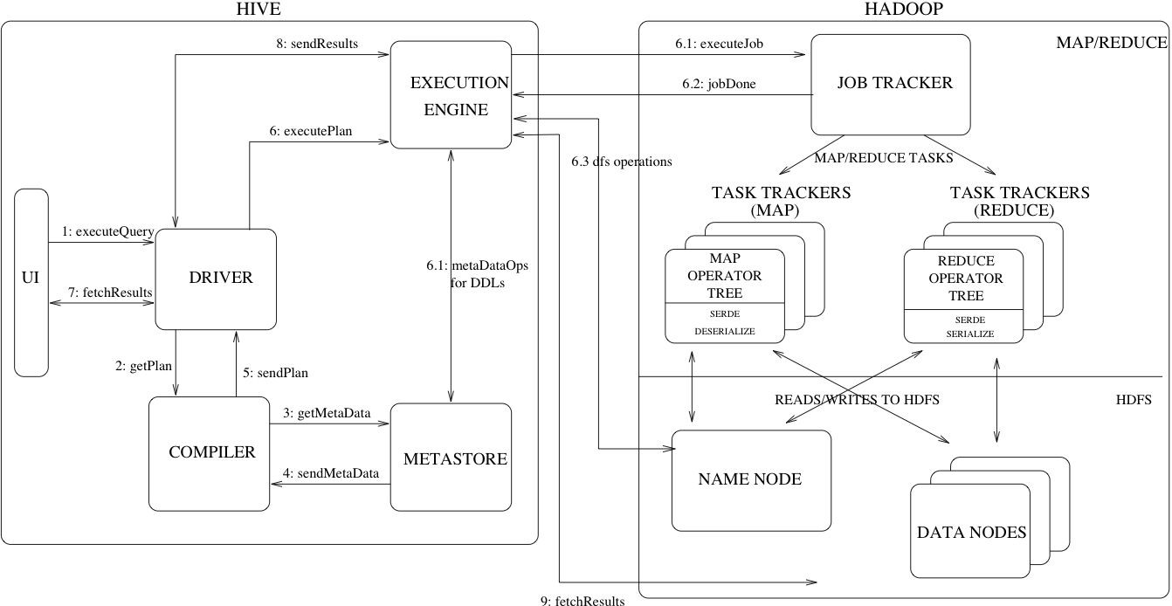
Hive building blocks
Distributed tasks with MapReduce
,
Tez (Workflow) or
Spark
Figure source: https://cwiki.apache.org/confluence/display/Hive/Design

Slide 81
Hive data organization
Schema-on-read approach
schema inferred from data, structured and unstructured data
Databases
Table
Managed table versus External tables
External table: real data is stored outside Hive and referenced so delete only table metadata but not the data (read data only)
Table is mapped to a directory in HDFS
Low-level files: CSV, Apache Parquet,ORC, …
Managed vs External tables concept:
also in BigQuery, Snowflake, Databricks Lakehouse

Slide 82
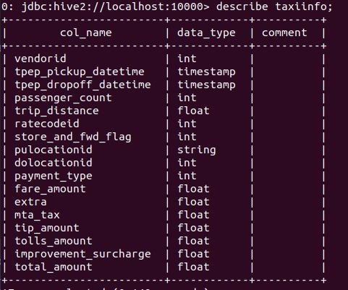
Example
Large tables lead to performance issues

Slide 83
Hive data organization for performance optimization
Partitioning: using value of a column as a partitioning key
partition keys determine how data in Table will be divided
E.g. date or countries
each partition is stored as a subdirectory
Avoid many sub directories!
Buckets: using a hash function of a column for grouping records into the same bucket
avoid large number of small partitions
each bucket is stored in a file
bucket columns should be optimized for join/filter operations

Slide 84





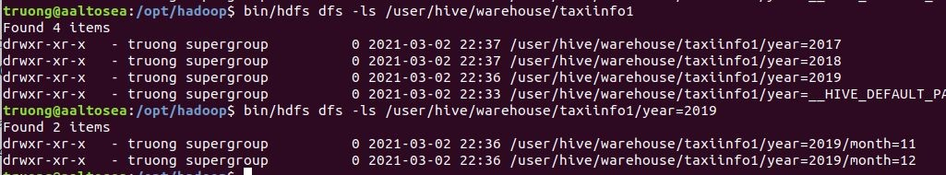
Example of partitions
CREATE TABLE taxiinfo1 ( ….) PARTITIONED BY (year int, month int)
…;
Indicate partition info
Define partition names
LOAD DATA LOCAL INPATH …… INTO TABLE taxiinfo1 PARTITION (year=2019, month=11);

Slide 85




Example of buckets
CREATE TABLE taxiinfo2 (VendorID int, ….) CLUSTERED BY (VendorID) INTO 2 BUCKETS
……;
Identify bucket column
Combine partitions with buckets

Slide 86
ACID
ACID support
for managed tables
different for CRUD and insert-only tables
Locks are used for data isolation
shared lock: for concurrent read of tables/partitions
exclusive lock: for modifying table/partition

Slide 87
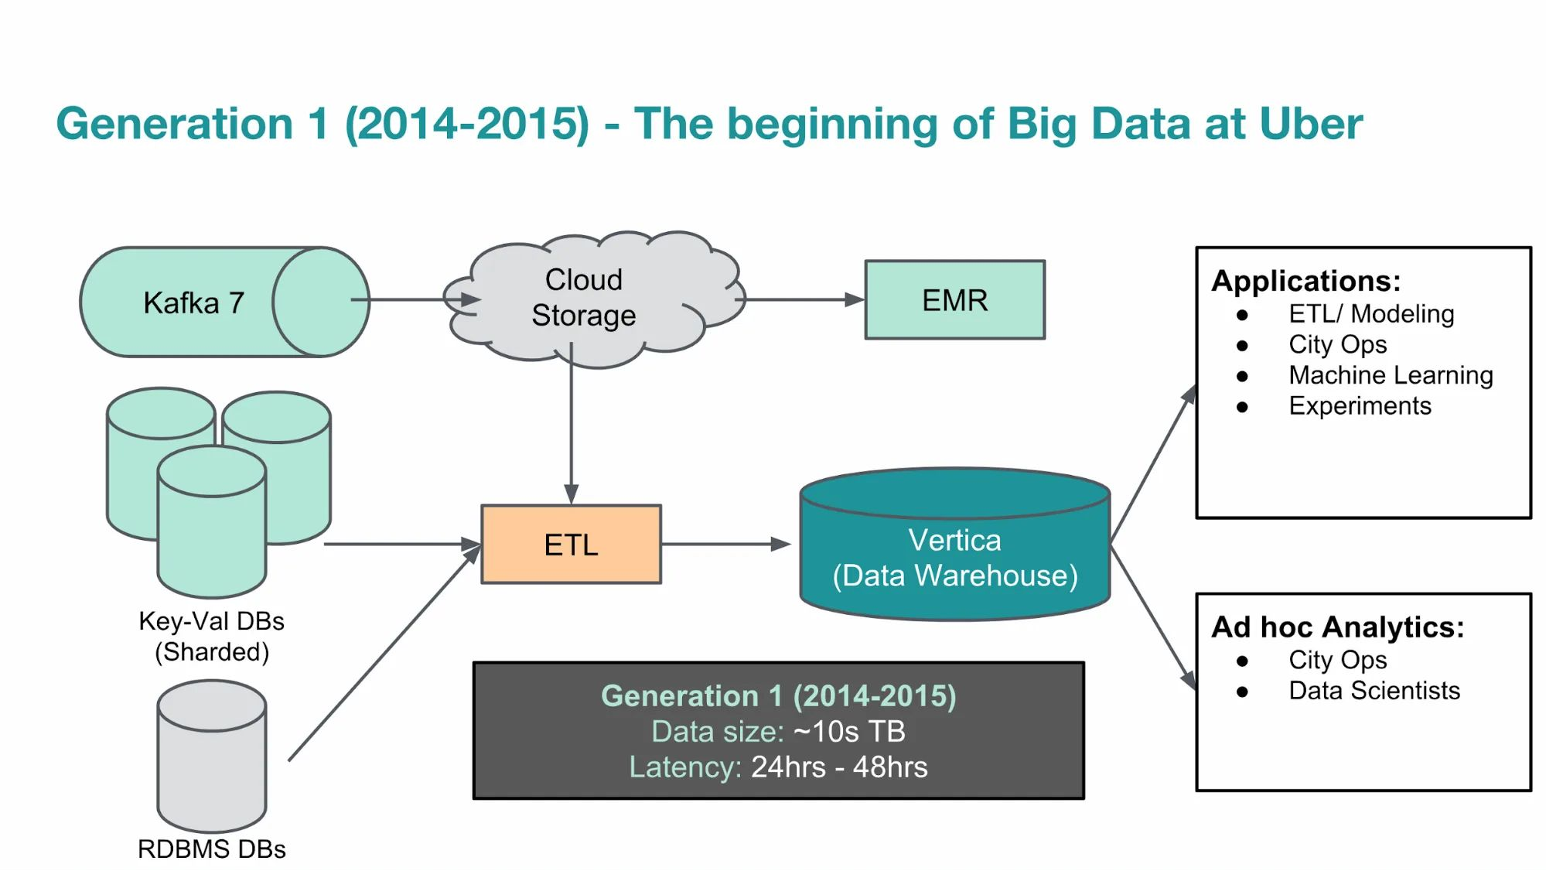
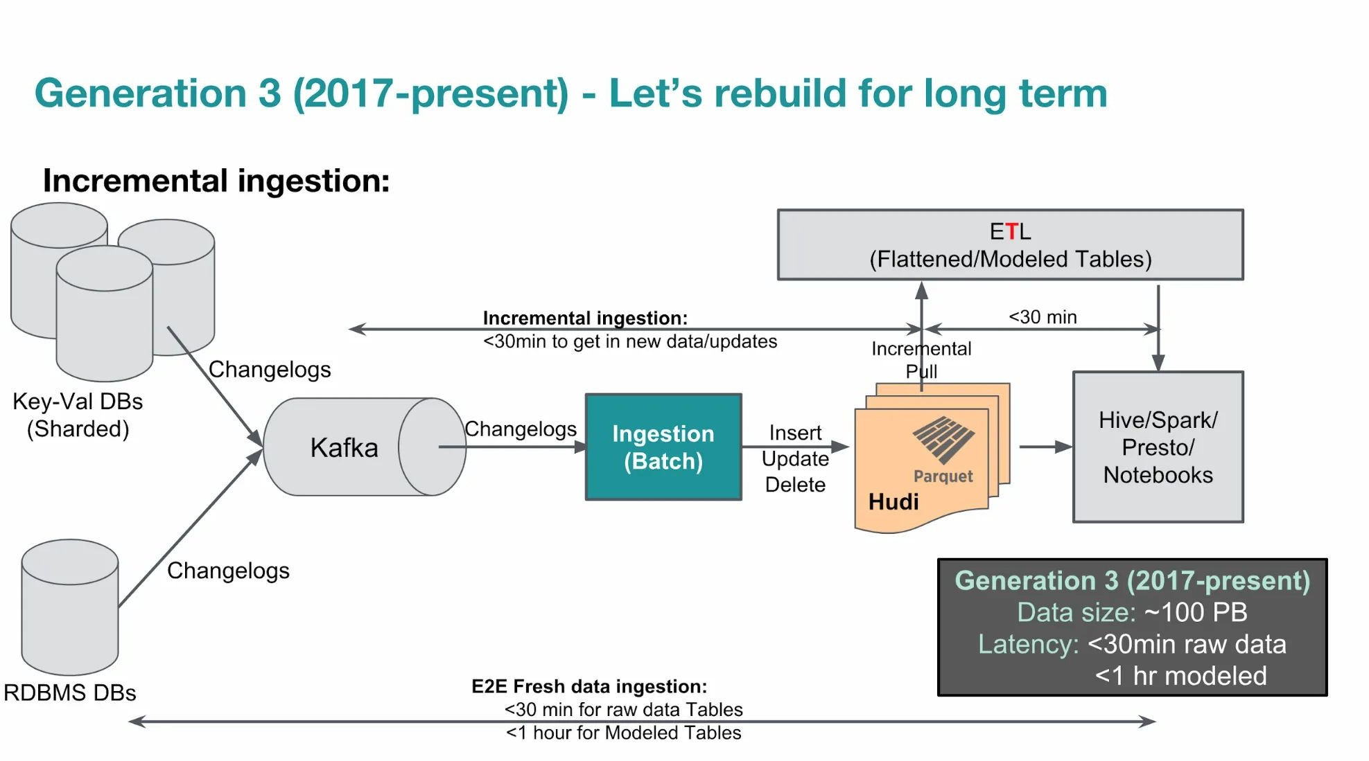
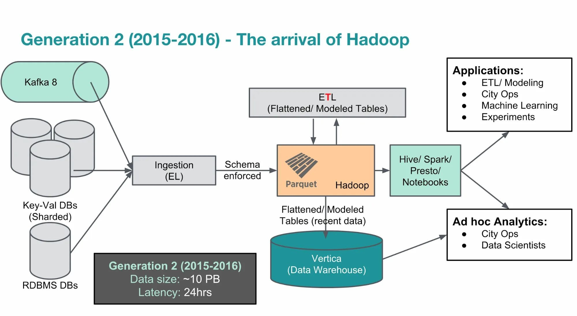
Uber example
Hive for analytics: “extremely large queries”, “ “20,000 Hive queries per
day” (see the source)
Figures source:
https://www.uber.com/en-FI/blog/uber-big-data- platform/

Slide 88
Hive in the age of ML
Hive has been around for a while → many goals have been diminished
But Hive Megastore continues an important role in data lakes and distributed data querying
power data management and discovery
support unified data management
enable “feature store”, discovery features used for machine learning

Slide 89
Summary
Hadoop software ecosystem is very powerful
many applications and use cases have been developed
Hadoop File System (HDFS) is a crucial subject
Managed Hadoop ecosystem services by cloud providers
try to look at Azure HDInsight, Google Dataproc, and Amazon EMR
High-level distributed query engineering using Hadoop components (HDFS, Hive)
Understand the combination of data management with data processing techniques in the same system
with Hadoop that simplify your big data tasks

